Slide 1
Classes and More
Module 8

Slide 2
Classes

Slide 3
Classes
A Class is a blueprint for an object
To create a class, we use the class keyword.
Classes always contain a special method called a Constructor
Remember: classes are not objects, they are blueprints for creating many objects

Slide 4
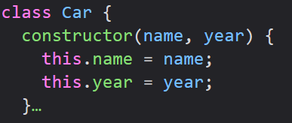
Constructors
Constructors are used to initialize an object’s properties.
When you create one, you must use the name “constructor” exactly as written
To use a constructor, you must use the new keyword. This will tell the computer that you want to create a new object.
If you forget to create a constructor, JavaScript will create an empty one for you

Slide 5


Class Methods
You can create methods for your classes using the same syntax as for an object.
Classes may have as many methods as you would like.
When you create an object from a class, all the methods and properties you defined for the class will be available to that object.

Slide 6
Classes
Classes are the basis for Object Oriented Programming (OOP)
OOP works by creating many objects and letting those objects interact
We’ll talk more about OOP in Module 13

Slide 7
JSON

Slide 8
JSON
JSON stands for JavaScript Object Notation.
JSON is the most widespread format for storing and transporting data
We will often use JSON for sending data from a server to a webpage.

Slide 9
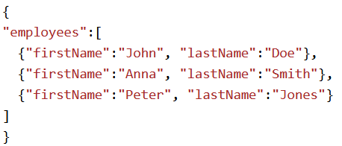
JSON
JSON is lightweight and language independent, meaning there is code for reading and writing JSON in every modern programming language.
JSON’s format comes from the way we write objects in JavaScript
Because of this, it is very easy to convert JSON data to an object and back.

Slide 10


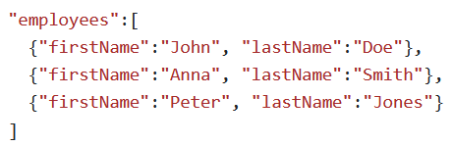
JSON Syntax
Data is written in Name/Value pairs
Note: JSON Names require double quotes.
Data is always separated by commas
Curly braces hold objects
Brackets hold arrays

Slide 11
Convert JSON to JS Object
We often use JSON to read data from a web server and then display that data on our websites
We can convert between JSON and JS object using the JSON.parse() method
We can then use the JSON data as an object in our code

Slide 12
Debugging

Slide 13
Code Debugging
Sometimes we make a mistake in our logic and there is no error message to tell us what to fix.
The process of finding these is called debugging.
Debugging is a vital part of programming and will take up a significant amount of the time we are developing software.

Slide 14
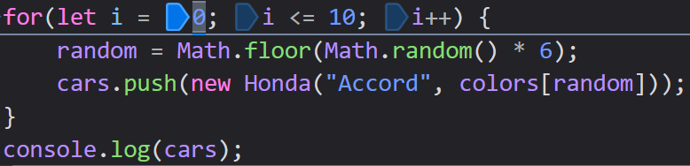

Debuggers
Especially in larger projects, Debugging can be very difficult.
All browsers have a debugger that allows us to step through our code line by line
Debuggers also offer us breakpoints, where our code will stop, so that we can see the value of our variables and the state of our program

Slide 15
JavaScript Style Guide

Slide 16
Coding Conventions
Coding conventions are a style guide for our JavaScript code.
Conventions cover:
Naming/declaration rules for variables and functions
Rules for use of whitespace, indentation, and comments
Programming practices and principles.
These conventions help our code stay consistent, readable, and easy to maintain.

Slide 17
Variable Name Recap
Variable and Function names use lowerCamelCase
All names must begin with a letter, underscore, or dollar sign, but most often a letter.

Slide 18
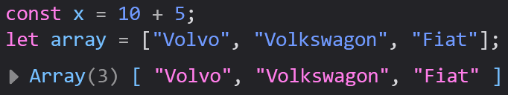
Spacing
It’s a best practice to put spaces around our operators.
This will make our code much easier to read.

Slide 19

Code Indentation
Our functions, classes, and any other code blocks that use curly braces should be indented (or spaced) to indicate that they are a part of the block.
W3Schools recommends you never use tabs to indent your code, because different editors interpret them differently.

Slide 20
Coding Conventions
These conventions are not used by your computer.
Conventions are purely for developers to read and understand their code and the code of others
Code will still run if you ignore all these conventions, but it will make your life (and other developers’ lives) more difficult

Slide 21
Best Practices

Slide 22
JavaScript Best Practices
Best Practices: Generally accepted methods for achieving software development
These recommendations help ensure that your code stays maintainable, scalable, and secure.

Slide 23
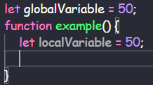
Avoid Global Variables
Global variables and functions are functions/variables that are declared outside of any block of code, such as functions, classes, try/catch blocks, etc.
These can be overwritten by other scripts or our own variables/functions, so we want to avoid using them.
Instead, declare your variables inside of a block, like inside of a function, to make sure our code stays consistent.

Slide 24
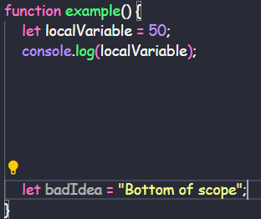
Declarations At The Top
It’s a good idea to declare all your variables at the top of your block of code
This will make your code look clean, give you a single place to look for variables, and make it less likely that you redeclare a variable.

Slide 25
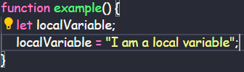
Initializing Variables
Initializing a variable means to assign it a value
If we try to access a variable that has not yet been assigned a value, we will get undefined
Initializing a variable when you declare it helps us avoid getting an undefined value

Slide 26
Never Declare Primitives as Objects
All primitives in JavaScript have an associated Object class.
Primitives have access to the methods of that Object, which is why we can use methods from a String or a Number.
If you declare your variables as objects, rather than primitives, you will slow down the speed of your scripts and introduce a lot of bugs

Slide 27
Avoid new Object()
We can declare an object using a Constructor, like we saw earlier
It will help us avoid bugs if we instead use curly braces.
The same goes for all primitives, arrays, functions, and RegExps

Slide 28


Only Use Strict Comparison
Like we have been doing so far, we should only compare using ===, never ==.
Comparing type and value will help avoid bugs and will keep our logic consistent with normal programming practices

Slide 29
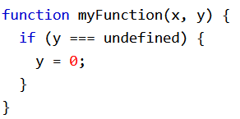
Use Parameter Defaults
When you have a function and you do not pass in a value for a parameter, JS will automatically pass in an undefined value
Undefined values will break your code if you were expecting a different type
We should either check for the type of our parameters at the start of a function, or we should assign a default value

Slide 30
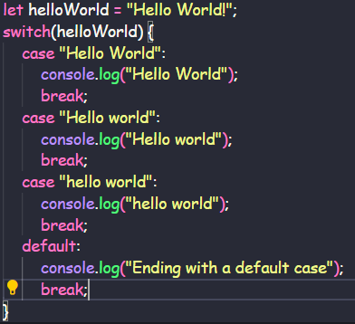
End Switch Statements with Default
It’s a good idea to add a Default case to your switch statements.
This will keep them functioning the way you expect them to even if you think you are safe to not use one.

Slide 31
Do Not Use eval()
eval() is used to interpret code, but there is functionally no use for it, since we already know how to run our code
Using eval() can cause serious security risks within your program.

Slide 32
Common Mistakes

Slide 33


= Vs ===
Since the assignment operator looks a lot like the comparison operator, it can be easy to forget they do different things
An assignment will return the value of the assignment rather than a Boolean like you were probably intending

Slide 34
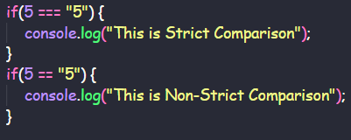
== vs ===
With a regular comparison (==), type does not matter, whereas with strict comparison (===), type must be the same
Using strict comparison will help you avoid Truthy vs Falsey values, which are a common source of confusion

Slide 35
Switch
Switch statements always use strict comparison (===).
You will never be able to use truth or falsey values when using a switch statement

Slide 36
Addition vs Concatenation
Addition is for doing Math with Numbers
Concatenation is for combining strings/arrays
Both use the same operator, but do different things

Slide 37




Floats
All programming languages struggle with Math using decimals
This often gives us an incorrect result
If precision is important, multiply all your decimals into an integer, then divide by the same number when you are done with the math

Slide 38
Misplaced Semicolons
A semicolon indicates the end of a statement.
If you were to place a semicolon at the end of an if/else/elseif, but before the braces, the code inside the braces would execute regardless of whether the condition was true

Slide 39
Line Breaks
You can continue your code onto the next line in most situations
You cannot break a String while you are inside of the quotes
You cannot line break on a return statement

Slide 40
Arrays with Named Indexes
JavaScript does not have associative arrays, in which you can access indexes with names.
Arrays must be accessed using Numbers

Slide 41

Ending Definitions with a Comma
Arrays and objects separate values with commas
You should never end an array or object with a comma
This will crash some browsers (Internet Explorer)

Slide 42
Performance

Slide 43


Reduce Activity in Loops
Ideally, we want our loops to do as little as possible
Any statement that does not need to be executed multiple times should removed from a loop
We can speed up execution of our loops by simplifying our loop conditions using variables

Slide 44

Reduce DOM Access
Accessing the DOM (basically our HTML doc) is very slow compared to most statements
If we need to do it multiple times, we should declare a variable for it

Slide 45
Keep HTML Pages Small
Our websites will be faster with fewer numbers of HTML elements
Additionally, fewer elements in a page speeds up the time to search a page with functions that access the DOM.

Slide 46
Reserved Words

Slide 47
Reserved Words
We cannot use our keywords as function, class, or variable names.
We can use our keywords inside of our names though
In the following slides, we’ll see a much larger list of most (but not all) of JavaScript’s keywords

Slide 48
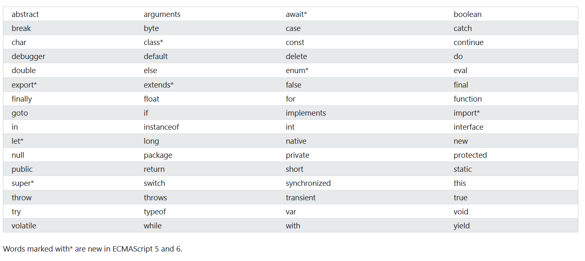
Reserved Words

Slide 49
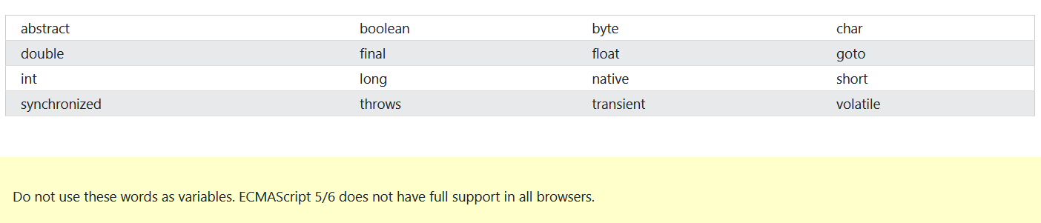
Removed Reserved Words

Slide 50
Java Reserved Words
JavaScript and Java are used together often in Full Stack applications, so we should avoid using its keywords as well

Slide 51
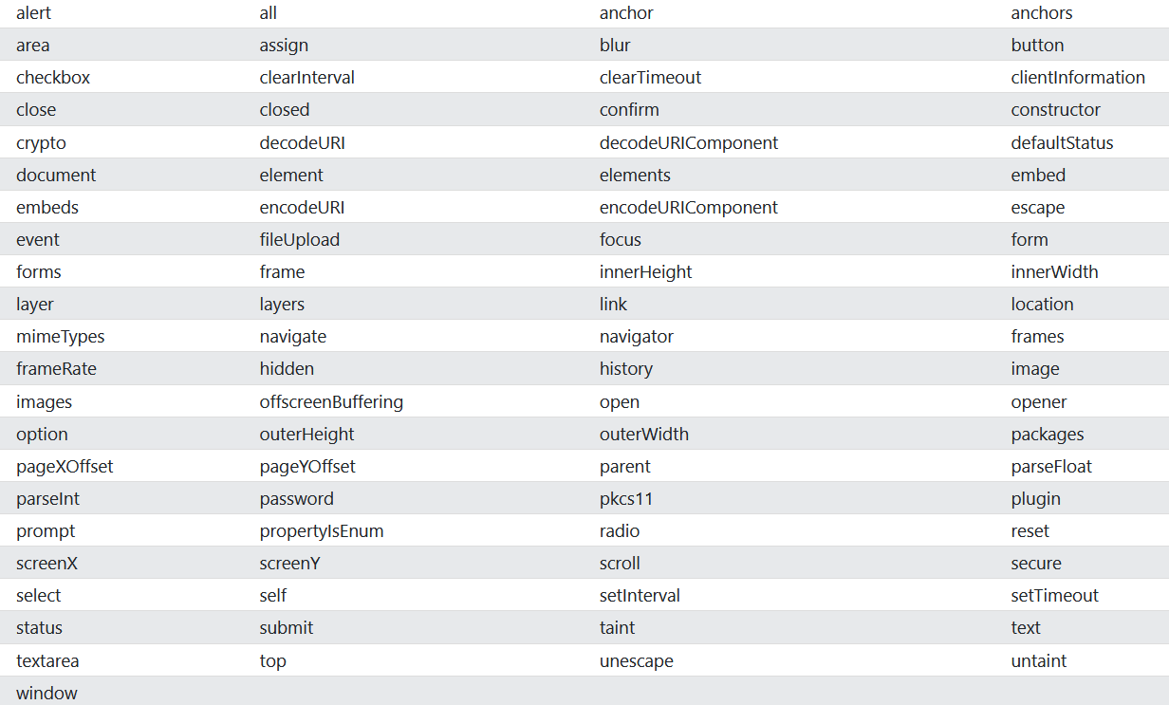
HTML and Window Reserved Words

Slide 52
HTML Events

